Slide 1
BIA-660 Web Mining Introduction

Slide 2
Agenda
Introduction
Name, major, interest, expectation from this course etc.
Syllabus
Course Overview: What is Web Mining?
Python Installation, Jupyter Notebook, Poll Everywhere
Python Review
Pre-Quiz

Slide 3
What is Web Mining
Most content on web is text
We will learn techniques to scrape text from the web and mine the text for various purposes:
Information Extraction
Question and Answering
Sentiment Analysis
…
Therefore, Web Mining is closely related to Natural Language Processing (NLP)
What is NLP? https://www.youtube.com/watch?v=CMrHM8a3hqw

Slide 4
Information Extraction
Event: Curriculum mtg
Date: Jan-16-2012
Start: 10:00am
End: 11:30am
Where: Gates 159
Subject: curriculum meeting
Date: January 15, 2012
To: Dan Jurafsky
Hi Dan, we’ve now scheduled the curriculum meeting.
It will be in Gates 159 tomorrow from 10:00-11:30.
-Chris
Create new Calendar entry
Source: Natural Language Processing, Lecture Slides from the 2012 Stanford Coursera course by Dan Jurafsky and Christopher Manning,
http://spark-public.s3.amazonaws.com/nlp/slides/intro.pdf

Slide 5
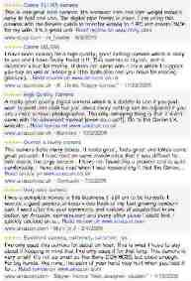

Information Extraction & Sentiment Analysis
Attributes:
zoom
affordability
size and weight
flash
ease of use
Size and weight
✓
nice and compact to carry!
since the camera is small and light, I won't need to carry around those heavy, bulky professional cameras either!
the camera feels flimsy, is plastic and very light in weight you have to be very delicate in the handling of this camera
✓
✗
Source: Natural Language Processing, Lecture Slides from the 2012 Stanford Coursera course by Dan Jurafsky and Christopher Manning,
http://spark-public.s3.amazonaws.com/nlp/slides/intro.pdf

Slide 6
Question Answering: IBM’s Watson
Won Jeopardy on February 16, 2011!
WILLIAM WILKINSON’S
“AN ACCOUNT OF THE PRINCIPALITIES OF WALLACHIA AND MOLDOVIA”
INSPIRED THIS AUTHOR’S
MOST FAMOUS NOVEL
Bram Stoker
Source: Natural Language Processing, Lecture Slides from the 2012 Stanford Coursera course by Dan Jurafsky and Christopher Manning,
http://spark-public.s3.amazonaws.com/nlp/slides/intro.pdf

Slide 7


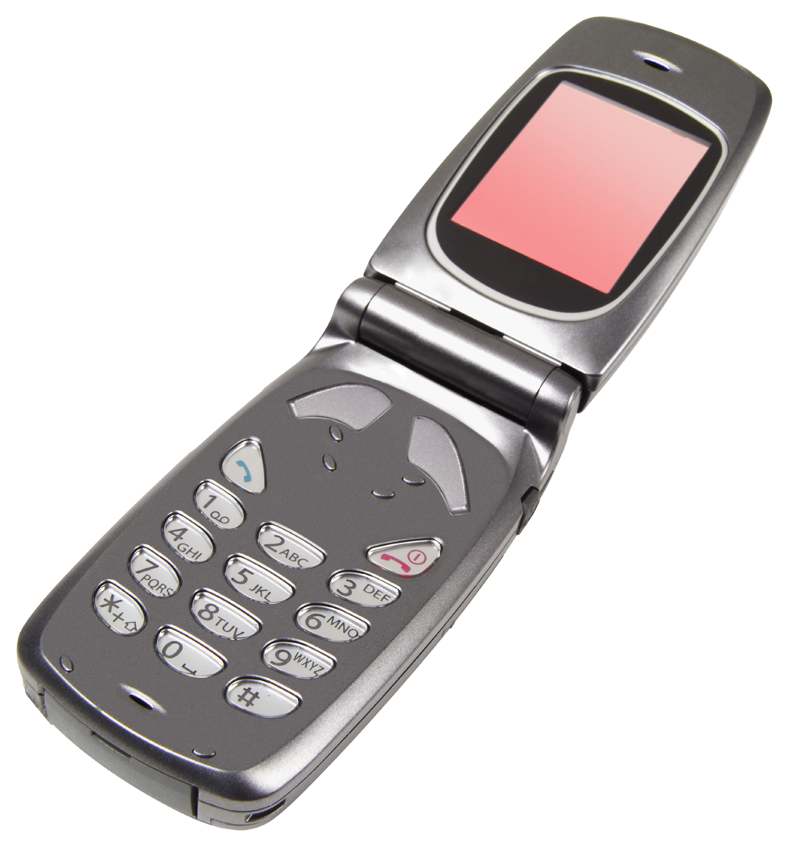

Language Technology
making good progress
Sentiment analysis
still really hard
mostly solved
Best roast chicken in San Francisco!
Question answering (QA)
The waiter ignored us for 20 minutes.
Spam detection
Coreference resolution
Q. How effective is ibuprofen in reducing fever in patients with acute febrile illness?
✓
Let’s go to Agra!
✗
Paraphrase
A nice gift for you …
Carter told Mubarak he shouldn’t run again.
Word sense disambiguation (WSD)
XYZ acquired ABC yesterday
Part-of-speech (POS) tagging
I need new batteries for my mouse.
ABC has been taken over by XYZ
ADJ ADJ NOUN VERB ADV
Summarization
Colorless green ideas sleep furiously.
Parsing
The Dow Jones is up
Economy is good
I can see Alcatraz from the window!
The S&P500 jumped
Named entity recognition (NER)
Machine translation (MT)
Housing prices rose
PERSON ORG LOC
第13届上海国际电影节开幕…
Dialog
Where is Citizen Kane playing in SF?
Einstein met with UN officials in Princeton
The 13th Shanghai International Film Festival…
Information extraction (IE)
Castro Theatre at 7:30. Do you want a ticket?
You’re invited to our dinner party, Friday May 27 at 8:30
Party May 27 add
Source: Natural Language Processing, Lecture Slides from the 2012 Stanford Coursera course by Dan Jurafsky and Christopher Manning,
http://spark-public.s3.amazonaws.com/nlp/slides/intro.pdf

Slide 8

BIA-66-A Topics Overview
Web Crawling
Extract and transform text from html, pdf, doc, xml, txt, …
Scrape static and dynamic web pages
Web Content
Extract words/terms
Part of Speech
Stemming/Lemmatization
Named Entity Recognition
Parsing
/Annotation
Query
Information Retrieval
Corpus
Vector Space Model
Word vectors
Feature Extraction
Supervised Learning
Classification
Sentiment mining
Sequence labeling
Text Mining
Unsupervised Learning
Clustering
Topic modeling (LDA)

Slide 9
Syllabus
See Canvas

Slide 10
Python and Python Editor Installation
Recommended: Anaconda. Instruction:
Download Anaconda (prefer Python 3.6 or above version) https://www.anaconda.com/products/individual
Install Anaconda following instruction at https://docs.anaconda.com/anaconda/install/index.html for windows or macOS
After installation, open a terminal (or anaconda command window for Windows) to update python libraries using: conda update --all
Pick Jupyter Notebook as the GUI editor. Launch it from “Anaconda Navigator” or type “jupyter notebook” from terminal (Mac users).
Make sure the following packages have been installed
gensim (4.0.1)
Matplotlib (3.3.2)
Nltk (3.5)
numpy (1.22.3)
Pandas (1.4.0)
spacy (3.0.5)
requests (2.24.0)
beautifulsoup4 (4.9.3)
selenium (3.141.0)
scikit-learn (0.23.2)
Scipy (1.5.2)
Seaborn (0.11.0)
Statsmodels (0.12.0)
Note: The version is for your reference. You may not need to use the exact version

Slide 11
Poll Everywhere
Simple in-class quiz is administered through Poll Everywhere
The quiz results will be counted as your class participation
To participate:
Click “Sign up” at https://www.polleverywhere.com and register using your Stevens Email ID, if you don’t have an account at Poll Everywhere yet
With your account created, now you can login our class poll site: PollEv.com/emilyliu
You should be able to see a test poll (the question is: "Have you used any of the Python Packages below?"). Please respond to this question.

Slide 12
Python Pre-Quiz
The purpose of this quiz is to understand the level of your Python skills so that I can plan the course accordingly
This pre-quiz does not count toward your grades
Sample questions:

